Slide 1


Perfect Diamond
Team 4: Karla Murphy, Patricia Berry, Justin Merryman, Cade Culver

Slide 2

Introduction/About Our Data
Diamonds have been defined as a girl’s best friend, but we wanted to know more about the diamond trade. Our team investigated pricing and the anatomy of a diamond to determine whether we could predict pricing and help the user to buy the best choice for their budget and preference. To choose the perfect diamond, you must follow the 4C’s that determine the price of the diamond.
The data was selected from Kaggle and was in a csv format. The data set was medium in size and we were able to use it as is without taking a random sample. The data selected was very clean and only one column was deleted as it mirrored the index column.

Slide 3
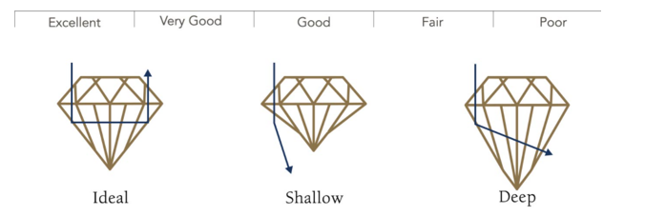
The 4 C’s- Cut
The most important of the 4 C’s is cut. Cut drives how much a diamond sparkles.

Slide 4
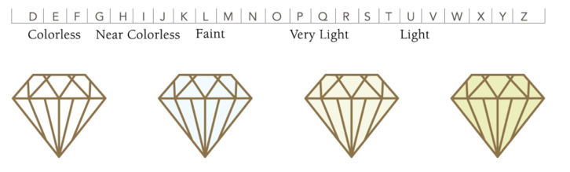
The 4 C’s- Color
Color is the second most important feature in diamond selection. The less color that a diamond has the higher the grade of the diamond.

Slide 5
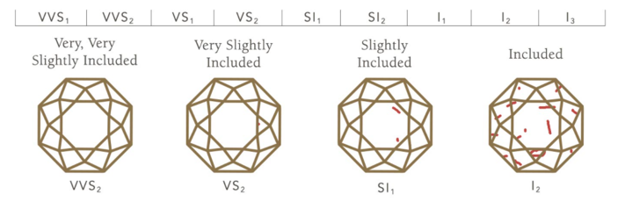
The 4 C’s- Clarity
Clarity defines the degree that a diamond is flawed. Clarity grade is based on the size, number, position of, and color of the diamond’s flaws.

Slide 6
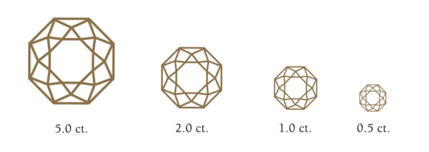
The 4 C’s- Carat Weight
Carat weight refers to a diamond’s total weight; not size.

Slide 7
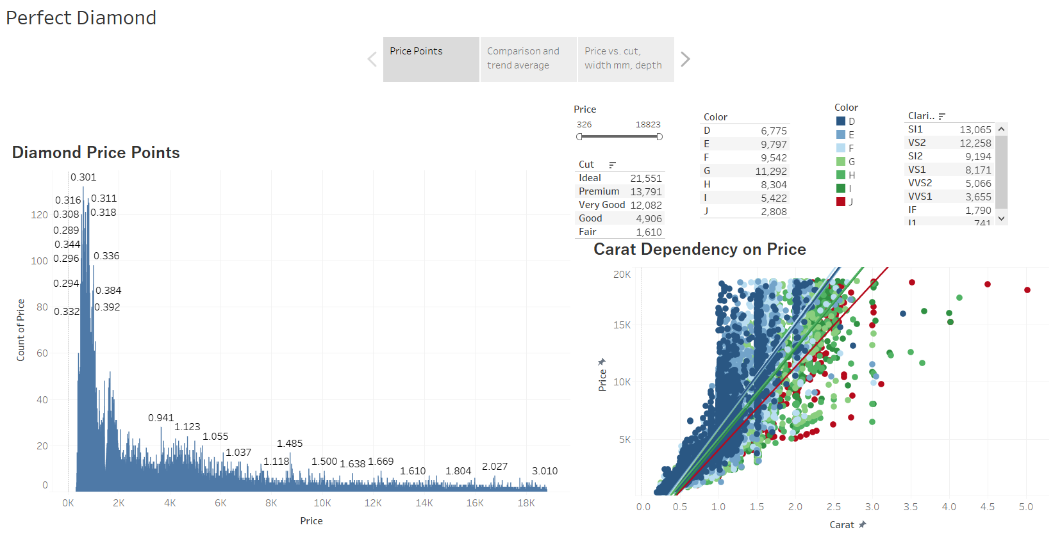
Tableau-Price Points
Three dashboards were created to visualize the different features of diamonds. The first dashboard is broken up into two segments. The chart on the left identifies the number times a certain price point occurred. The maximum price in this case was over $18 K. Most of the diamonds sold are below $2 K. The second chart highlights the carat dependency on price. Filters at the top allow the user to choose cut, color and clarity.

Slide 8
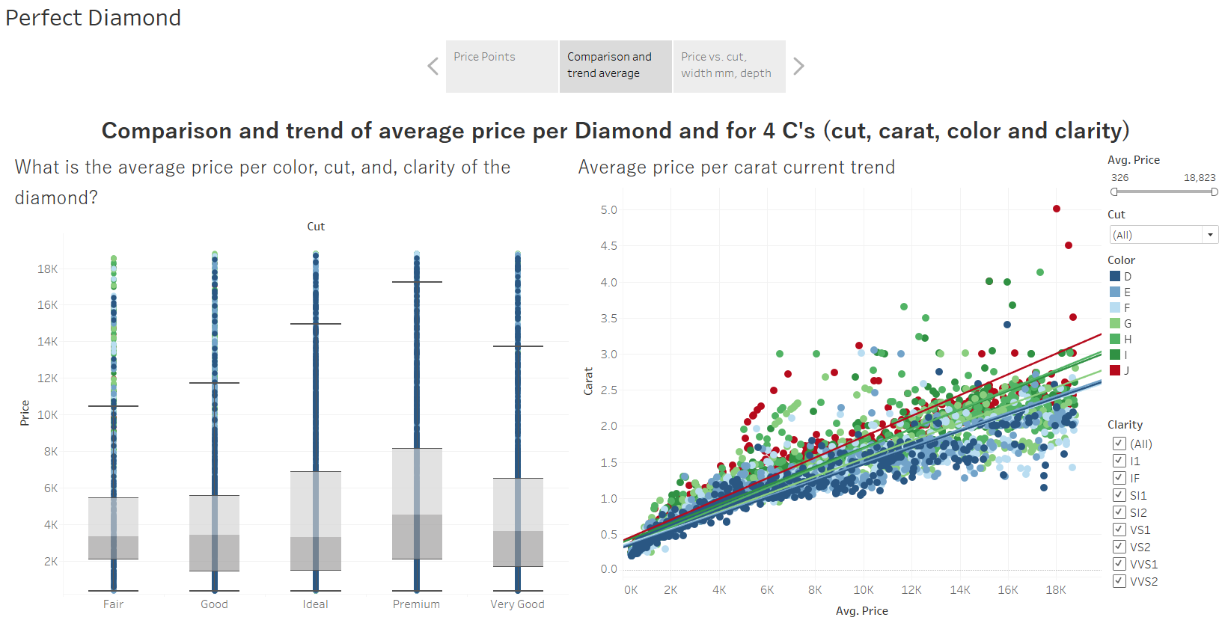
Tableau-Price and the 4 C’s
The second dashboard covers the comparison and trend of average price per Diamond and the 4C’s (cut, carat, color, and clarity). There are filters to switch between the 4C’s to understand the trend between the 4 different features. The first chart looks at how cut affects price. The second chart looks at the average price per carat in a scatter chart and identifies the trends.

Slide 9
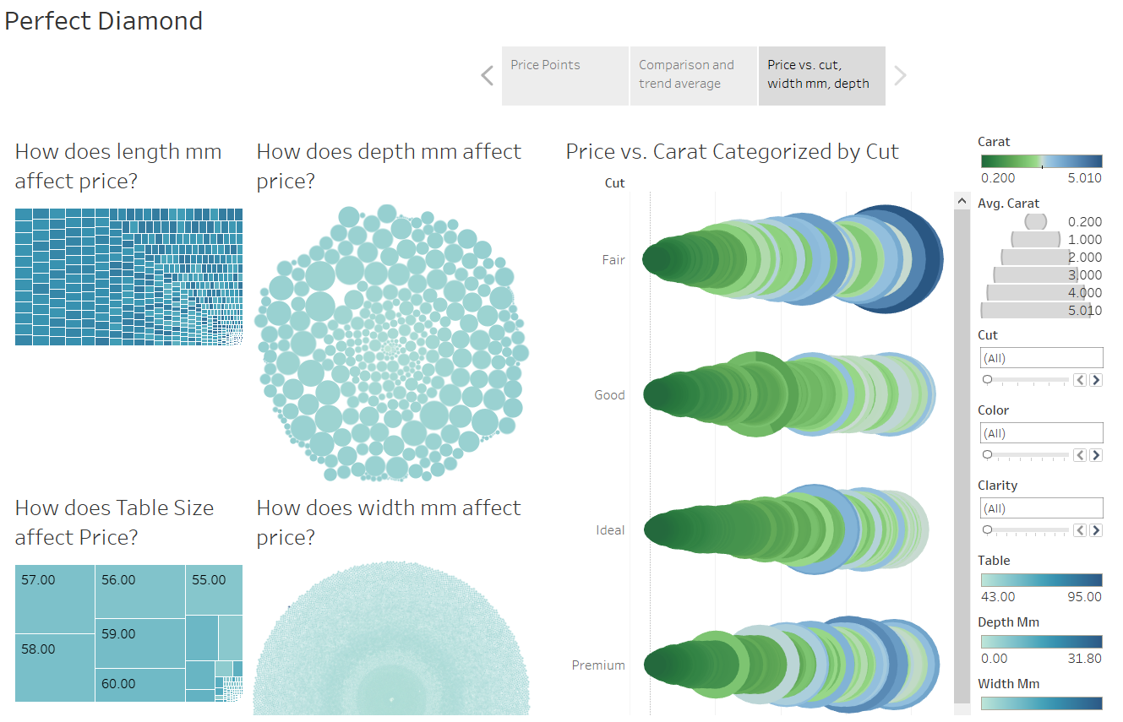
Tableau-Carats, Cuts, Widths and Lengths
The final dashboard dives into the remaining data points contained within the data set and how price affects those measures. We look at length mm, width mm, depth mm, carat weight and table size. Filters allow the user to switch between cut, color and clarity.

Slide 10
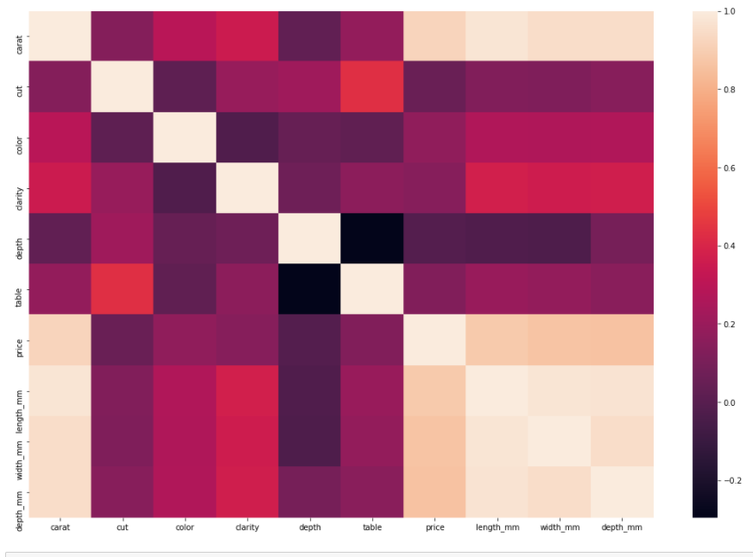
Machine Learning Correlation
The machine learning module was created to give an end user the opportunity to identify the price of a diamond based on their choices between carat weight, color, clarity and cut. The data was put through several tests to identify the best model to use for the predictive application. The first step was to identify correlations within the data.

Slide 11
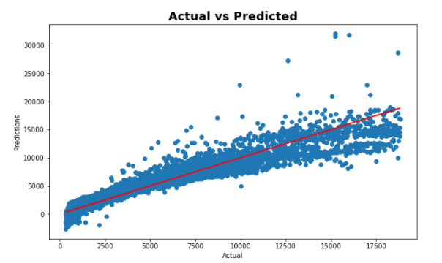
Machine Learning Linear Regression
The in sample R2 score was 0.9092517263784572 and the in sample RMSE was 1201.9520820408259. The out sample R2 score was 0.9076446121106826 and the out sample RMSE was 1211.675332479086.

Slide 12
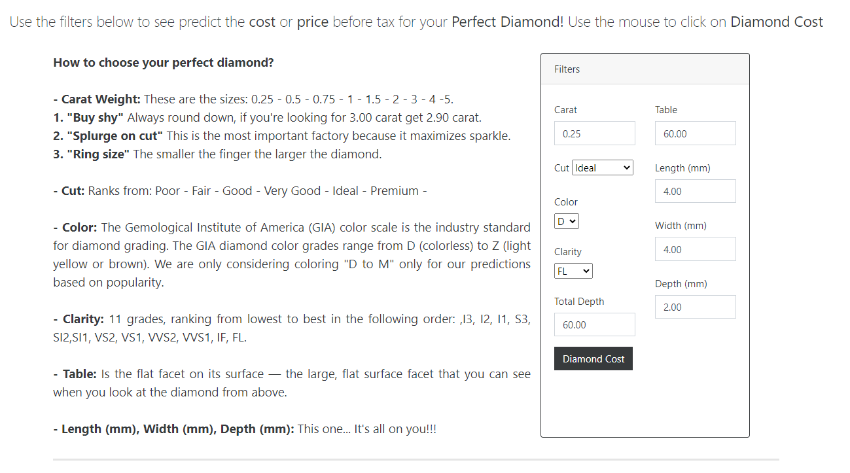
The Predictor: User Interface

